Slide 1
GRAPH ADT
CPSC 131 - Data Structure
Shrinivas Patil

Slide 2
Graphs
Graph: vertices (nodes) connected by edges
Foundational data structure
Many applications
0
1
2
3
4

Slide 3
Sketching Graphs
Vertex: circle
May have index drawn inside
Plural: “vertices”
Edge: arrow between two vertices
0
1
2
3
4

Slide 4
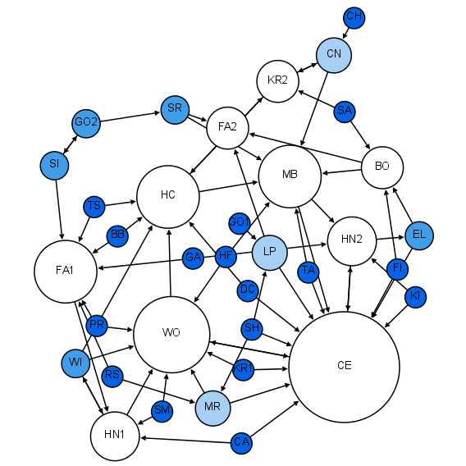
Networks
A vertex corresponds to a junction
An edge corresponds to a link between junctions
Image Credit: Martin Grandjean, CC BY-SA 4.0 https://creativecommons.org/licenses/by-sa/4.0, via Wikimedia Commons

Slide 5
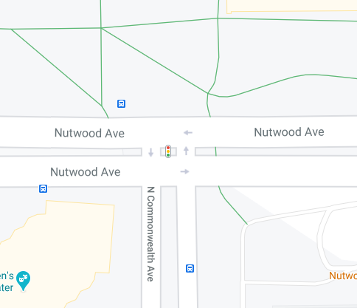
Example: Road Network
Vertex corresponds to intersection
Edge corresponds to road segment
Image credit: Google Maps

Slide 6

Example: Social Network
Alice
Vertex corresponds to person
Edge corresponds to friendship/follow relationship
Dan
Bob
Carol

Slide 7
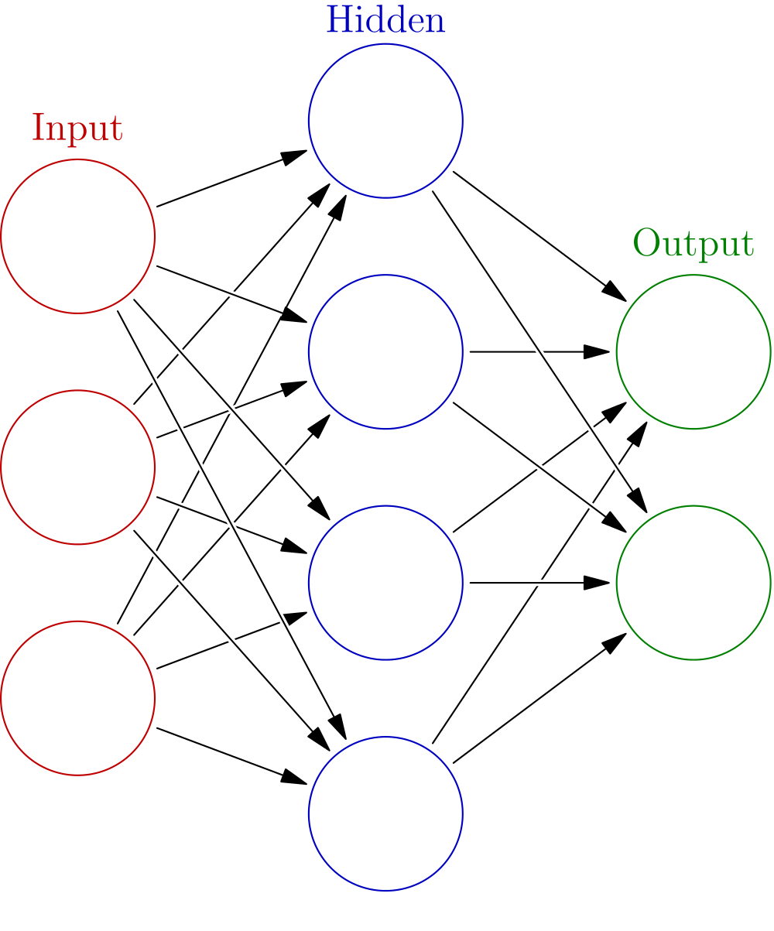
Example: Neural Network
Vertex corresponds to nerve cell
Edge corresponds to dendrite
Image Credit: Glosser.ca, CC BY-SA 3.0, https://creativecommons.org/licenses/by-sa/3.0, via Wikimedia Commons

Slide 8
Graph, Vertex, Edge, Ends
Vertex: one site in a graph
Plural: vertices
Each vertex is a math object
Often, vertices are the set of indices {0, 1, …, n - 1}
Edge: connection between two vertices
Math pair (i, j) is a directed edge from i to j
Directed: one-way travel from i to j
Source: start vertex i
Target: destination vertex j
The ends of an edge are its source and target
0
1
2
3
4

Slide 9
Directed and Undirected
Directed edge: one-way connection
So far all edges have been directed
Drawn as an arrow
Undirected edge: two-way connection
Math set {i, j} is an undirected edge between i and j
Drawn as a straight line segment (no arrowhead)
Still has two ends
No defined source or target
Directed graph: every edge is directed
Undirected graph: every edge is undirected
0
1
2
3
4

Slide 10
Incoming, Outgoing, Loop
Outgoing edges of vertex v: directed edges whose source is v
Incoming edges of vertex v: directed edges whose target is v
Loop edge: source and target are the same
Could be directed or undirected
0
1
2
3
4

Slide 11
Adjacent, Incident
0
1
2
Vertex v is adjacent to vertex w, if there is an edge from v to w
Relationship between two vertices
Directed graph: order matters, not necessarily symmetric
Undirected graph: order doesn’t matter, symmetric
Edge e is incident to vertex v, if v is one of e’s ends
Relationship between an edge and a vertex
3
4
0
1
2
3
4

Slide 12
Degree
0
1
2
deg(v) = degree of vertex v = number of edges incident to v
Count the touching edges
In a directed graph,
In-degree of v = count of v’s incoming edges
Out-degree of v = count of v’s outgoing edges
Preview: some adjacency list operations take O(deg(v)) time
3
4
0
1
2
3
4

Slide 13
Path, Cycle, Simple Path
0
1
2
Path: sequence of vertices v₀, v_{1,} …, v_{k-1} such that each v_{i} is adjacent to v_{i+1}
Intuitively: legal trip through the graph
Cycle: path where v₀=v_{k-1}
Starts and ends at the same vertex
Simple path: path where each vertex is unique
Does not contain any cycle
3
4
0
1
2
3
4

Slide 14
Reachable (Directed Graph)
0
1
2
Vertex d is reachable from vertex s if there exists a path from s to d
s = start
d = destination
In a directed graph, unreachable vertices are a dead end
3
4
0
1
2
3

Slide 15
Reachable, Connected, Component (Undirected Graph)
0
1
Vertex d is reachable from vertex s if there exists a path from s to d
s = start
d = destination
In an undirected graph, unreachable vertices are in a different component
Component: set of vertices that are all reachable from each other
Undirected graph has one or more components
Connected graph: all vertices are in a single component
2
3
4
0
1
2
3
4

Slide 16
Graph ADT
0
1
2
3
4
This video: directed graph ADT
Later: adapter to implement undirected graph
n = number of vertices
m = number of edges
Vertices are indexed [0, n - 1]
 | 0 | 1 | 2 | 3 | 4
0 | 0 | 1 | 0 | 0 | 0
1 | 0 | 0 | 1 | 0 | 0
2 | 0 | 0 | 0 | 1 | 0
3 | 0 | 1 | 0 | 0 | 1
4 | 1 | 0 | 0 | 0 | 0

Slide 17
Directed Graph Operations
Create(n): create a new directed graph with n vertices and no edges
VertexCount() return n
EdgeCount(): return m
HasEdge(i, j): return true if there is an edge from i to j, false otherwise
AddEdge(i, j): add a directed edge from i to j
RemoveEdge(i, j): remove the edge from i to j; throw exception if no such edge
OutEdges(i): return a vector of every j such that HasEdge(i, j)
InEdges(j): return a vector of every i such that HasEdge(i, j)

Slide 18
Example: HasEdge, OutEdges, InEdges
0
1
3
2
4
8
7
5
6
9
10

Slide 19
Directed Graph Asymptotic Efficiency
Graph Operation | Adjacency Matrix | Adjacency List
Create(n) | O(n²) | O(n)
VertexCount(), EdgeCount() | O(1) | O(1)
AddEdge(i, j) | O(1) | O(1)
RemoveEdge(i, j) | O(1) | O(deg(i))
HasEdge(i, j) | O(1) | O(deg(i))
OutEdges(i) | O(n) | O(deg(i))
InEdges(j) | O(n) | O(n+m)
n = number of vertices
m = number of edges
deg(i) = degree of vertex i

Slide 20
Adjacency Matrix Overview
Adjacency is defined between two vertices
AddEdge(i, j)
Can represent 2D information in a 2D array or 2D vector
Recall: vertices indexed 0, 1, …, n - 1
Adjacency matrix
n × n matrix A of Booleans
Also int n, m
Adjacency matrix invariant:
A[i][j] = true when there is an edge from vertex i to vertex j

Slide 21
Sketching an Adjacency Matrix
0
1
2
3
4
n × n grid
Fill a cell with 1 for true, 0 for false
A[i][j] = 1 when there is an edge from i to j
Math convention
i is the row number (vertical), 0 at top
j is the column number (horizontal), 0 at left
Also sketch n, m
 | 0 | 1 | 2 | 3 | 4
0 | 0 | 1 | 0 | 0 | 0
1 | 0 | 0 | 1 | 0 | 0
2 | 0 | 0 | 0 | 1 | 0
3 | 0 | 1 | 0 | 0 | 1
4 | 1 | 0 | 0 | 0 | 0
n = 5
m = 6

Slide 22
Initial Observations
0
1
2
3
4
Finding an edge is an array lookup
O(1)
OutEdges(i) involves looping through a row
O(n)
InEdges(j) involves looping through a column
O(n)
 | 0 | 1 | 2 | 3 | 4
0 | 0 | 1 | 0 | 0 | 0
1 | 0 | 0 | 1 | 0 | 0
2 | 0 | 0 | 0 | 1 | 0
3 | 0 | 1 | 0 | 0 | 1
4 | 1 | 0 | 0 | 0 | 0
n = 5
m = 6

Slide 23
Adjacency Matrix in Undirected Graph
0
1
2
3
4
Represent matrix as follows
If there is an edge from vertex i to j, mark adjMat[i][j] as 1.
If there is no edge from vertex i to j, mark adjMat[i][j] as 0.
Try the above example and create adjacency matrix for undirected graph.

Slide 24
Adjacency List
Array of linked list is used to represent the edges between two vertices.
Each Index represents vertex in a graph
Every index contains linked list of adjacent nodes
Let’s assume there are n vertices in the graph So, create an array of list of size nas adjList[n].
adjList[0] will have all the nodes which are connected (neighbour) to vertex 0.
adjList[1] will have all the nodes which are connected (neighbour) to vertex 1 and so on.

Slide 25
Sketching an Adjacency List
n = 5, m = 6
n = 5, m = 6
 | 0 | 1 | 2 | 3 | 4
0 | 0 | 1 | 0 | 0 | 0
1 | 0 | 0 | 1 | 0 | 0
2 | 0 | 0 | 0 | 1 | 0
3 | 0 | 1 | 0 | 0 | 1
4 | 1 | 0 | 0 | 0 | 0
0
1
2
0
1
1
2
3
2
3
4
3
1
4
4
0

Slide 26
Initial Observations
Each list is “right-sized”
Length of list = number of relevant edges
More compact
Form of data compression
Should be faster

Slide 27
Degree
deg(v) = degree of vertex v = number of edges incident to v
Count the touching edges
adj[i] = list of the outgoing edges of i
Length of adj[i] = deg(i)
Looping through adj[i] takes O(deg(i)) time
Similar to how looping through a hash table bucket takes O(L) time

Slide 28
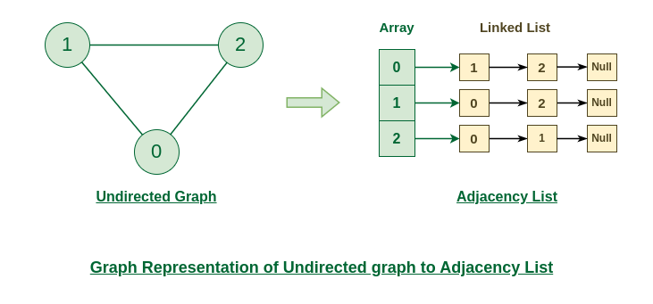
Adjacency List in Undirected Graph

Slide 29
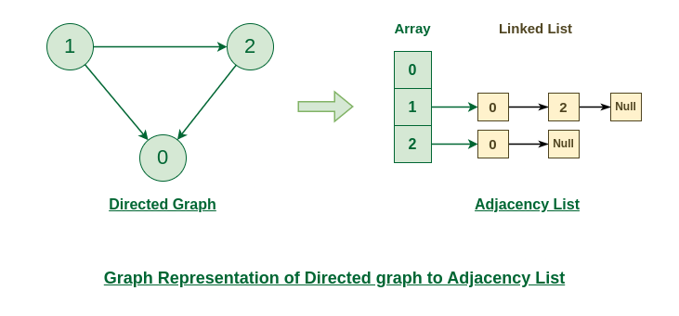
Adjacency List in Directed Graph

Slide 30
Traversal Techniques in Graph
There are traversal techniques:
Depth First Search
Breadth First Search

Slide 31
Depth First Search (DFS)
Traversing or searching graph data
Starts with root node and explores every node as long as possible before backtracking
Depth-first:
dive “deep” into the graph, far away from start
track which vertices we’ve seen
when we reach a dead end (no unseen neighbors), back up one step and deep-dive again
Analogy: web surfing rabbit hole
Stack is used to visit each node in the graph

Slide 32
Recursive DFS
Mark every vertex not-seen
DFS(G, start): Visit start Mark start seen
Push all adjacent nodes of start in stack While stack:
Pop node v from stack
if v has not been seen: DFS(G, v)

